Slide 1

Autonomous combat vehicles
Bauman Moscow State Technical University
Student: Sanginov Azamat
Group: IU7-31
Moscow, 2018

Slide 2
Contents
History of ACV
First unmanned aerial vehicle
After WWII
Unmanned systems nowadays
Future of unmanned military systems
Ethical and moral issues of using autonomous systems in warfare

Slide 3
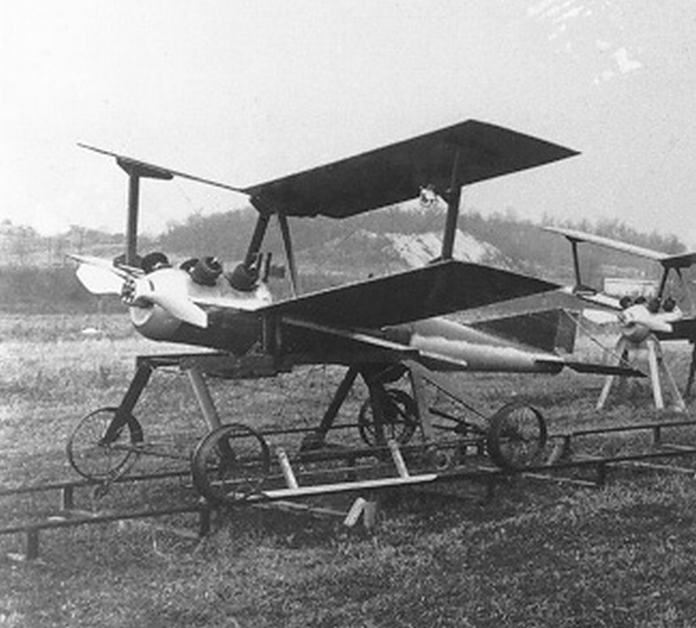
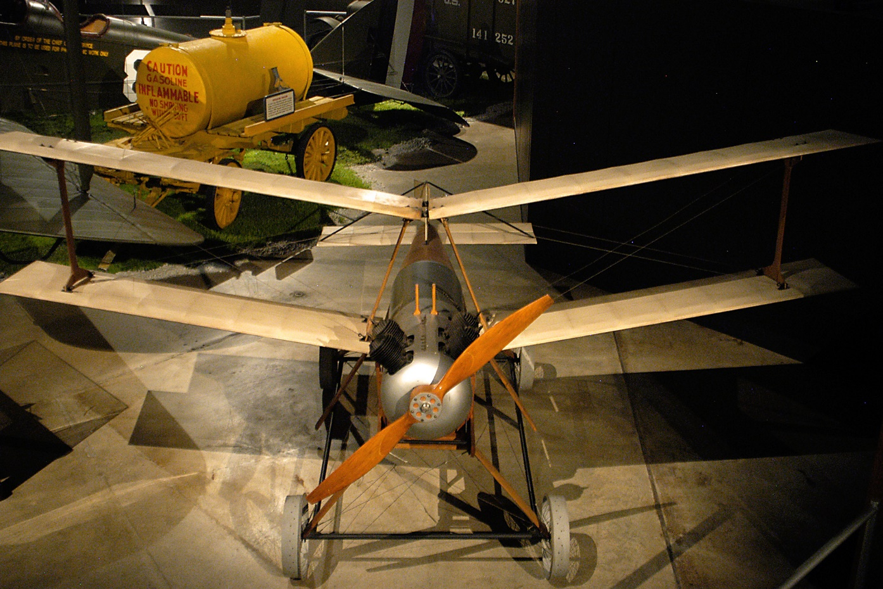
Kettering Bug
“Bug” before first flight, 1918

Slide 4
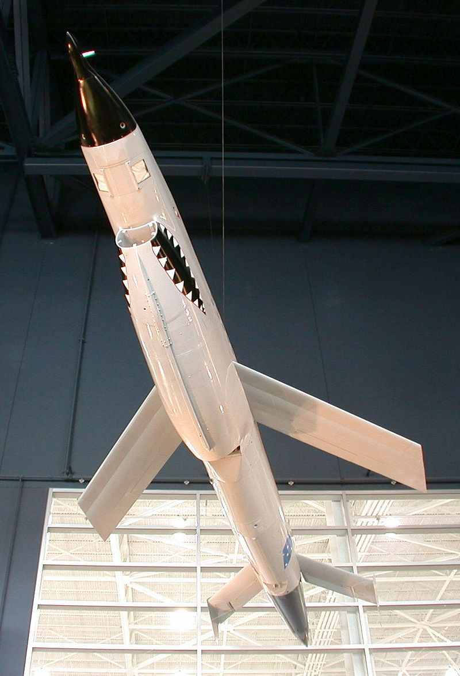
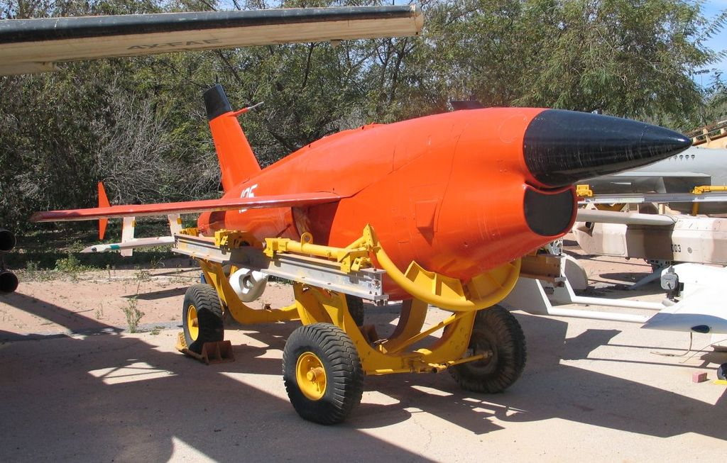
Ryan Aeronautical Company
Ryan Model 124 / BQM-34A Firebee
Model 147 at the Strategic Air Command & Aerospace Museum

Slide 5
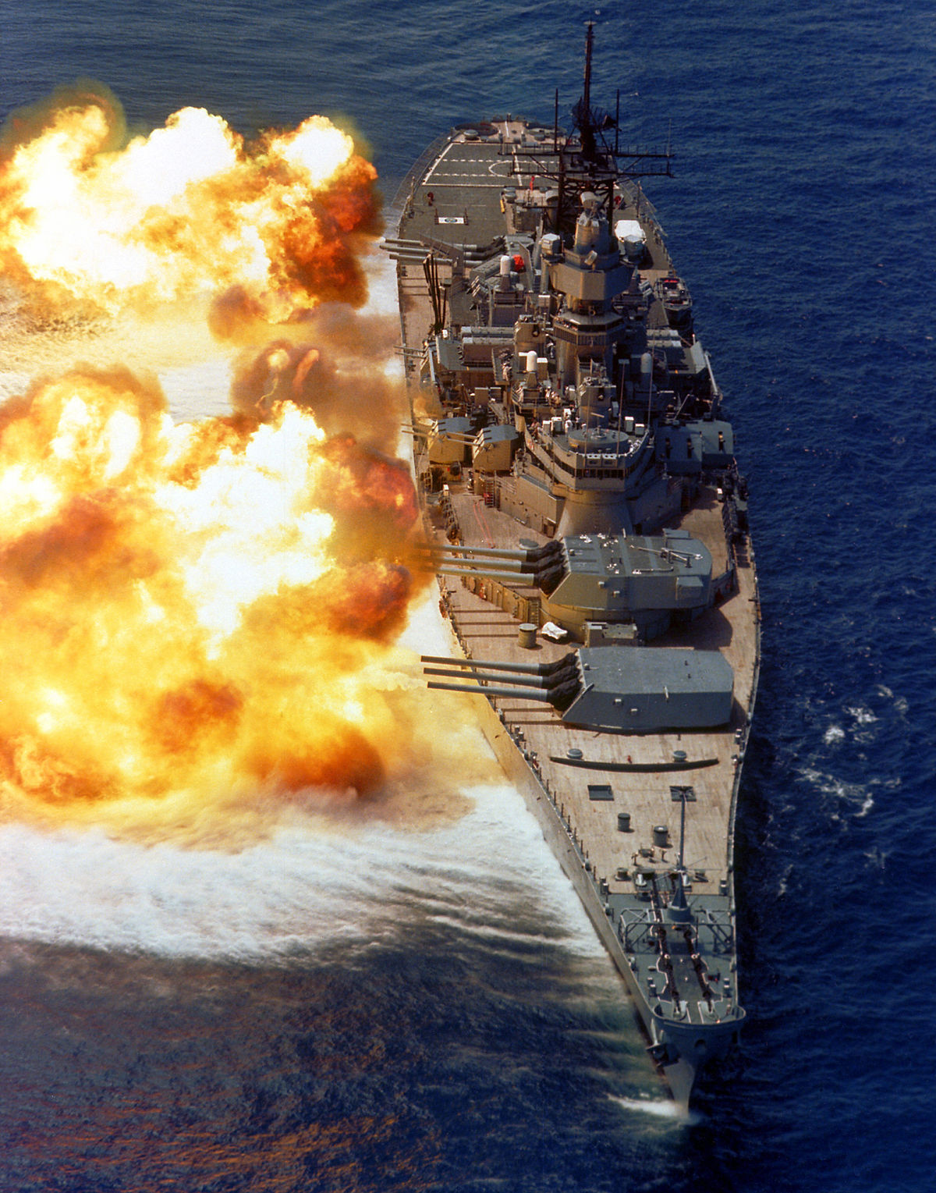
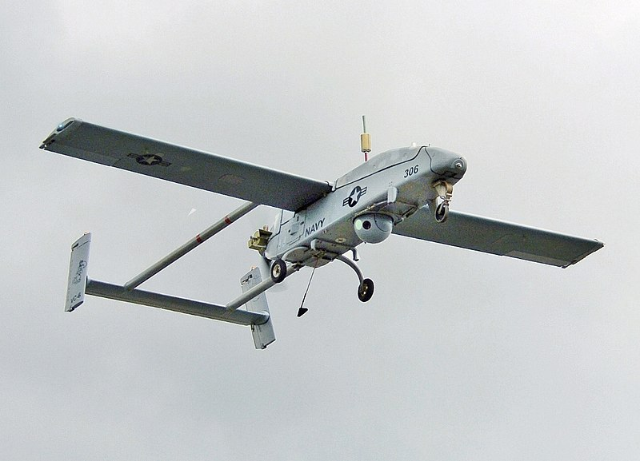
UAV’s nowadays
AAI RQ-2 Pioneer
USS Iowa (BB-61)
“The big stick”

Slide 6
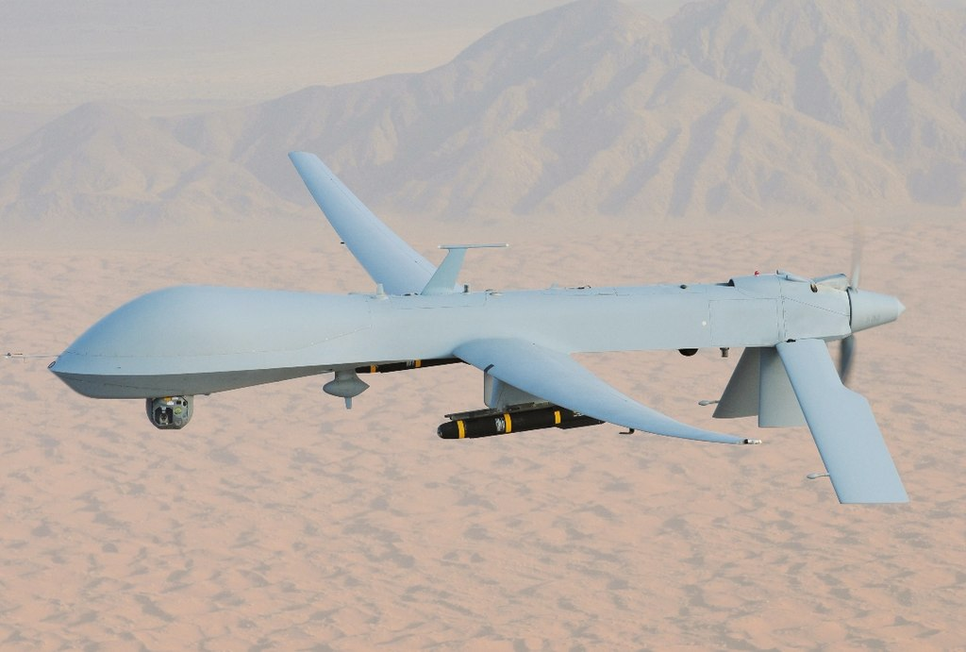
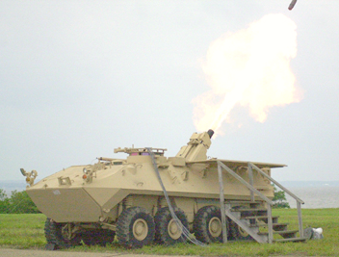
UAV’s nowadays
RQ-1 Predator armed with Hellfire missiles
Dragon Fire

Slide 7
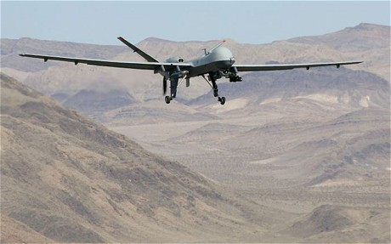
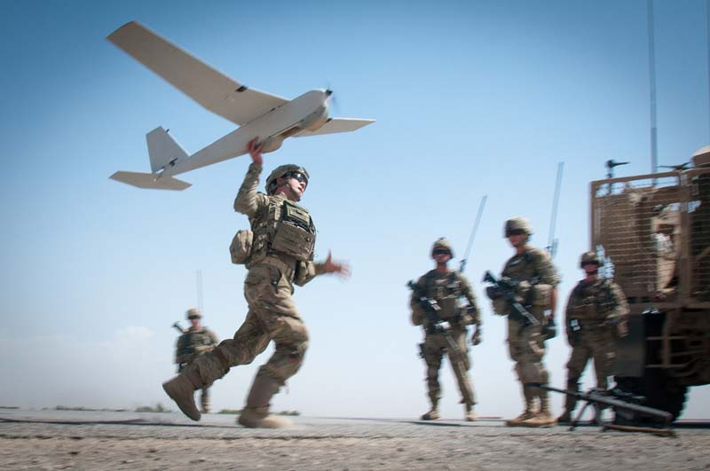
UAV’s nowadays

Slide 8
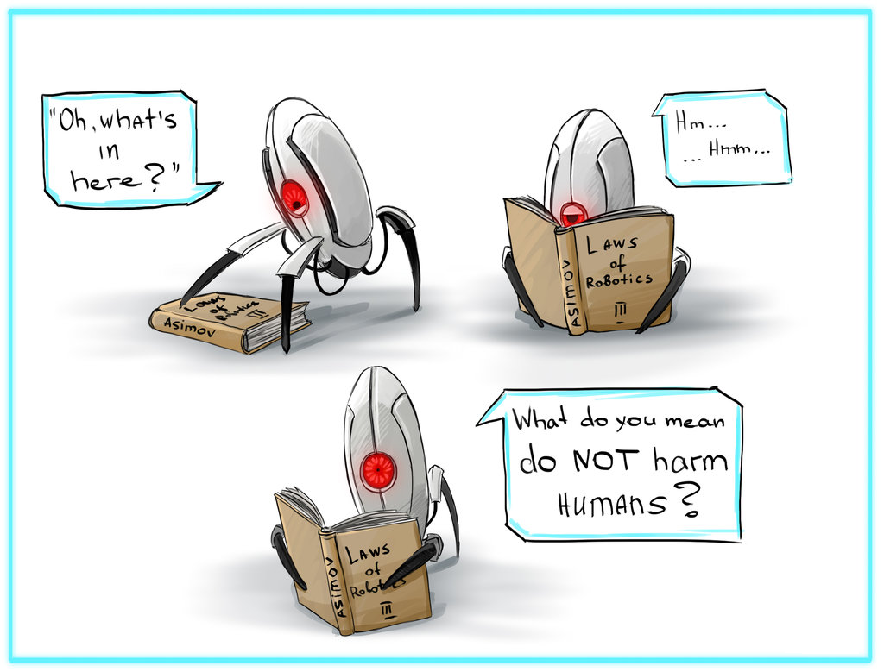
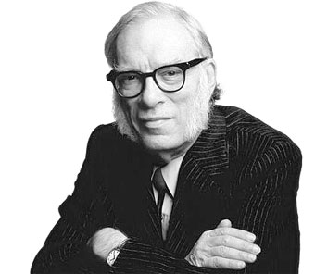
Ethical and moral issues
Isaac Asimov

Slide 9
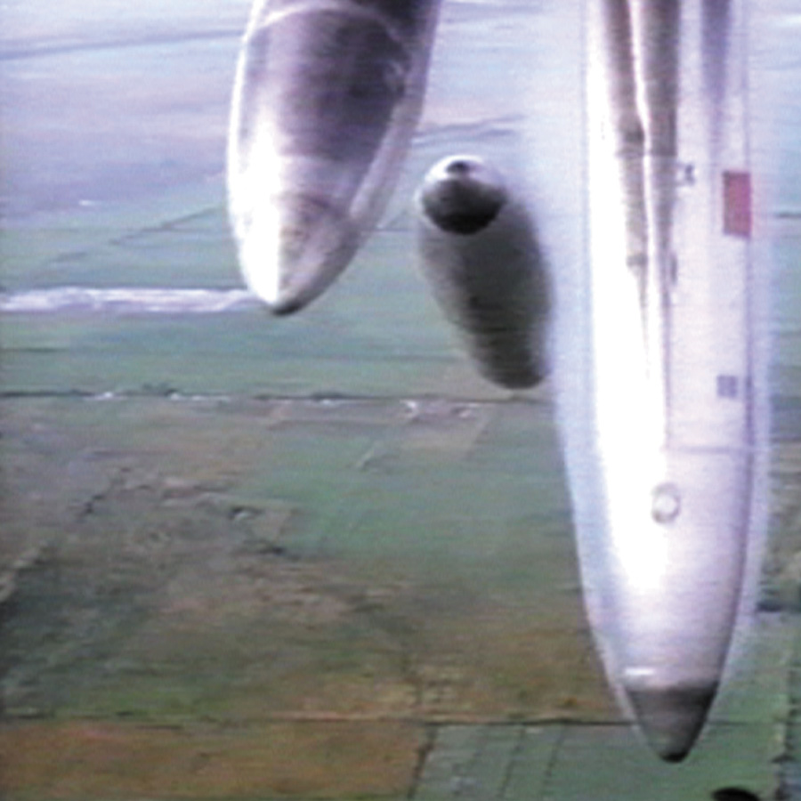
Rockets Fall on Rocket Falls

Slide 10
References
https://en.wikipedia.org/wiki/Kettering_Bug
https://en.wikipedia.org/wiki/Lethal_autonomous_weapon
https://en.wikipedia.org/wiki/Unmanned_combat_aerial_vehicle
https://en.wikipedia.org/wiki/Military_robot
https://en.wikipedia.org/wiki/Ryan_Model_147
https://en.wikipedia.org/wiki/Ryan_Firebee
https://news.cnrs.fr/opinions/a-guide-to-lethal-autonomous-weapons-systems
http://www.armyofrobots.com
https://www.ft.com/content/8deae2c2-088d-11e6-a623-b84d06a39ec2

